Slide 1
Mushroom Classification
The Identification of Edible mushrooms
For Agribusiness and Agricultural stakeholders
Presentation by Joshua Khoury

Slide 2
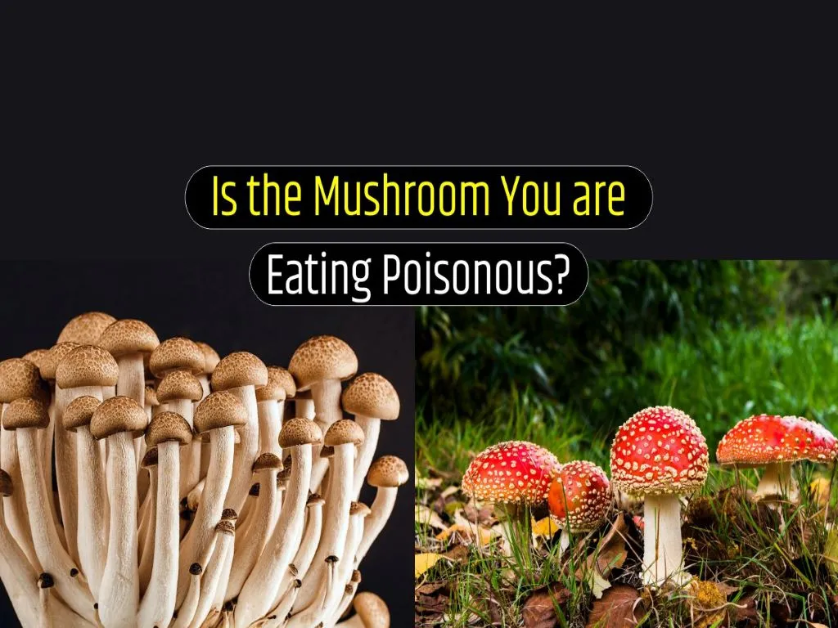
The Problem
Mushrooms are one of our most important vegetables (technically fungus, although for simplicity it falls under that category).
They have a myriad of health benefits and have become integral to cuisine and cooking.
This makes them dangerous for would be farmers or gatherers who want to use them or sell them.

Slide 3
Solution & Data
To that end I have created a predictive machine learning model which can predict whether or not a mushroom is edible or poisonous.
The model has been trained using data from the UCI Machine Learning Repository, which is a spreadsheet of over 8000 mushrooms detailing key attributes

Slide 4
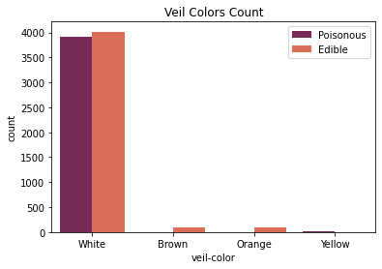
Figure 1
Here we have a countplot of all the mushrooms veils by color, and whether or not they are poisonous or edible.
Note that the few colors that are different however, are exclusively one class or another!

Slide 5
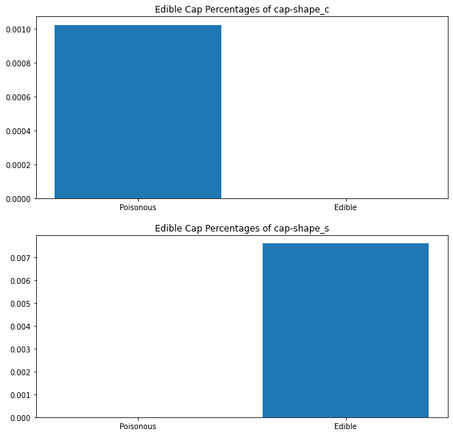
Figure 2
This here is the aggregated mean of Mushroom caps shape C & S, “Conical” and “Sunken”.
Conical mushrooms are exclusively poisonous, whilst Sunken are edible. However, they make up a very small percentage of all mushrooms sampled,
Based on both figures, singular features that are observed visually may not be safest in the identification of mushrooms.

Slide 6
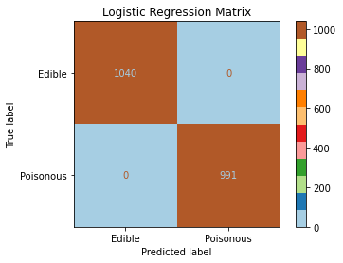
Model Strengths & Limitations
Strengths
My Logistic Regression model is 100% accurate.
It requires absolutely no tuning to reach this accuracy, its default parameters allows it to achieve these types of results
It is faster than the other models in its prediction times
Limits
Linear Regression is only for binary classification, if you wanted to predict other things you’d need a new model
It may only work best with specific features and values, the two most important features in identification were from Odor and Spore Print Color, this may mean if a dataset lacks those it may not perform as well.

Slide 7
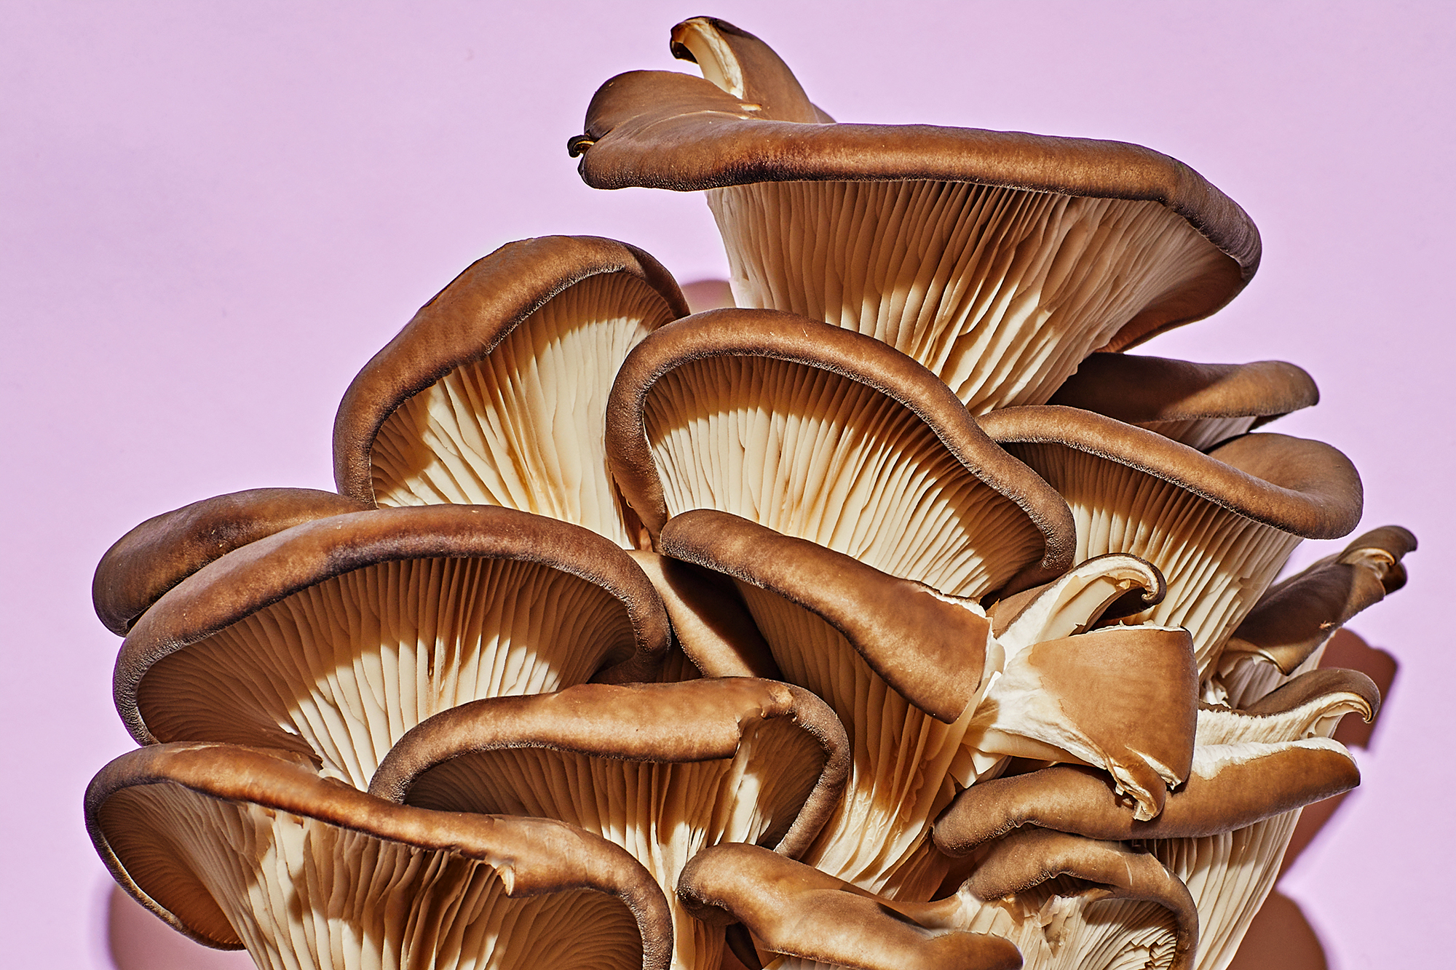
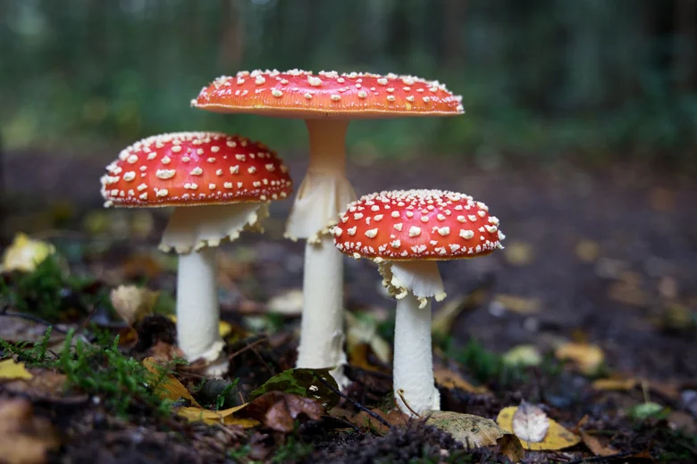
Recommendations
This Model would work best in predicting whether or not a mushroom is edible or not on datasets with incredibly high features or attributes to work with.
It should remain exclusively on binary classification since it is a Logistic Regression Model.

